Slide 1
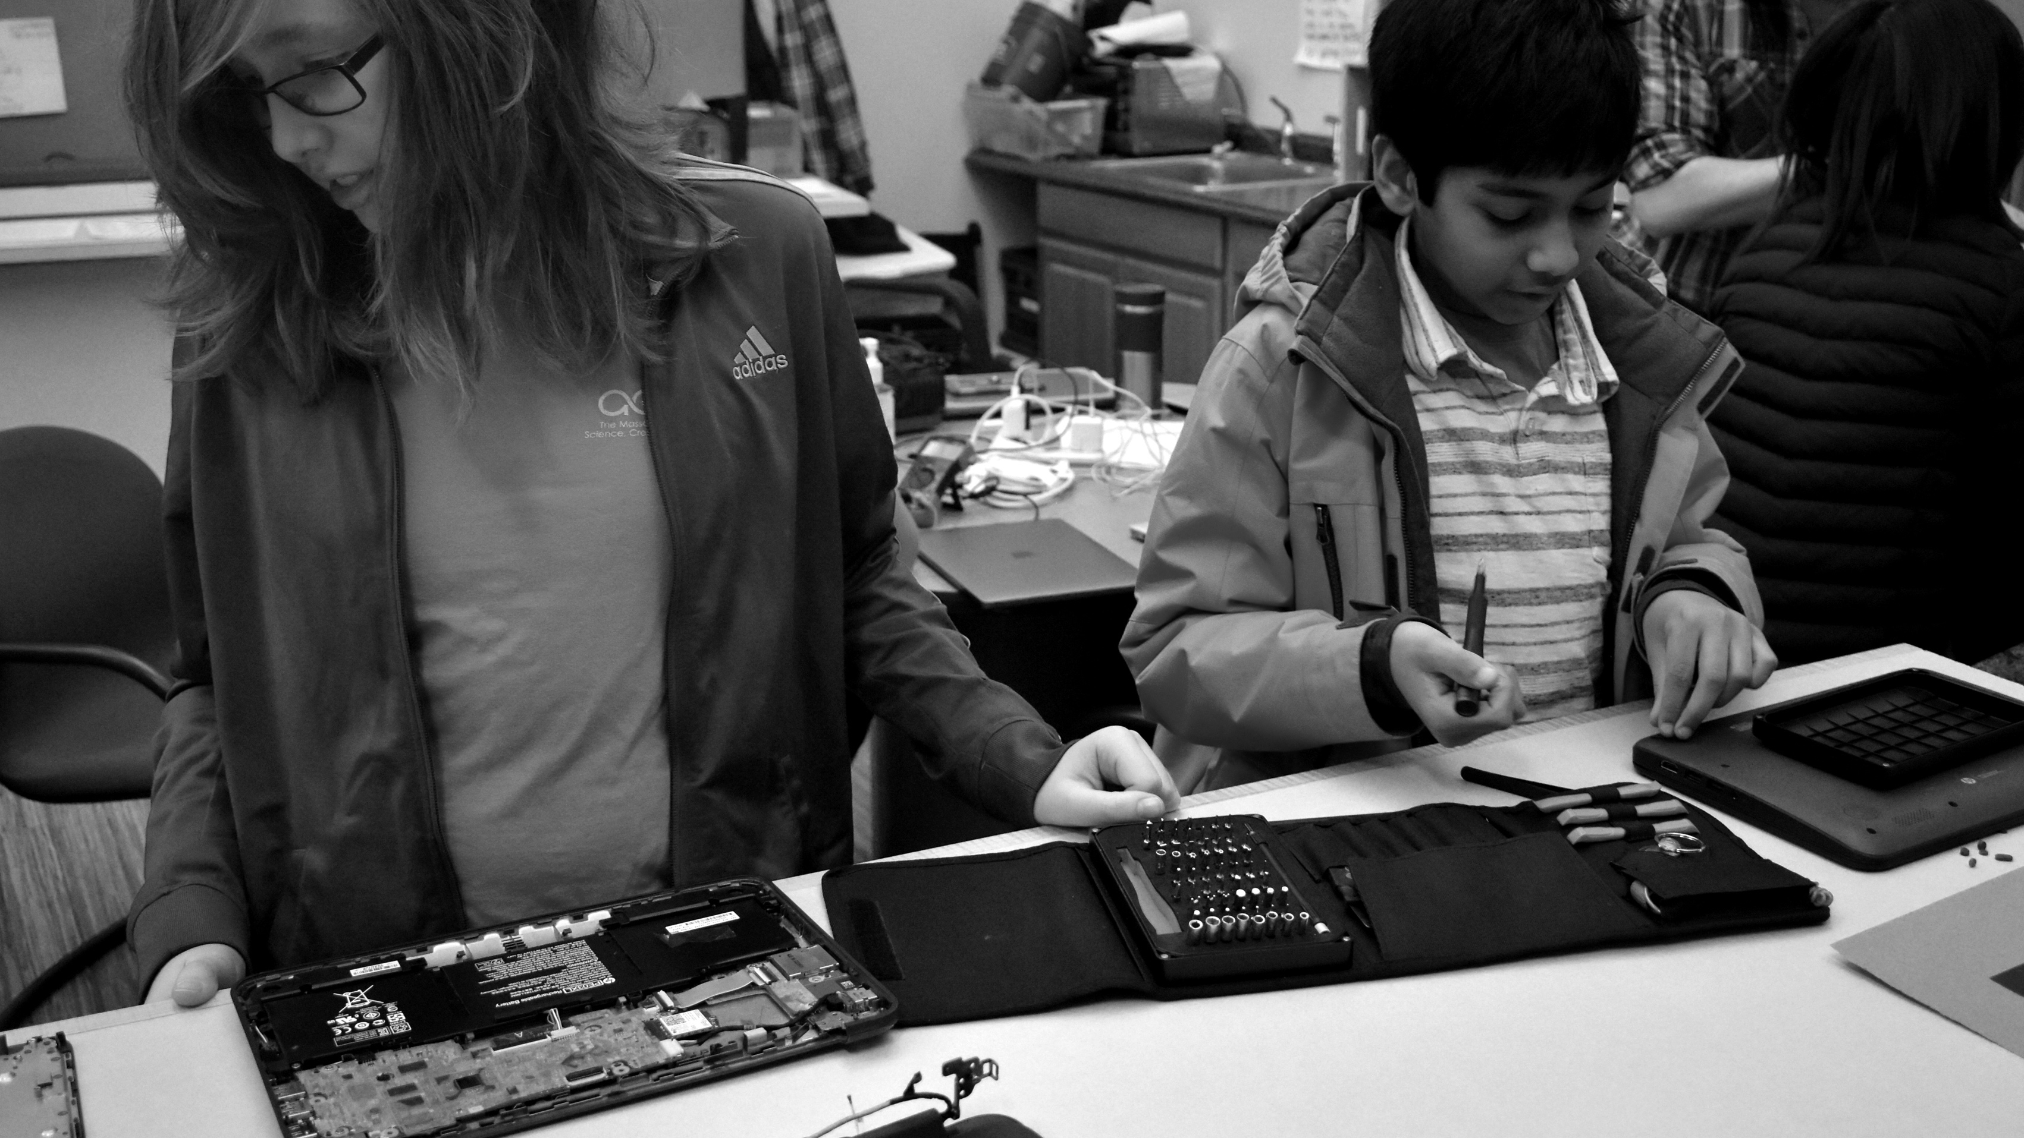

Develop the next generation of scientists, innovators and leaders
Notes:
“The purpose of the Acera Education Innovation Initiative is to transform STEM Education, and develop the next generation of scientists, innovators and leaders who are prepared to make positive impact against the challenges of our time. “

Slide 2
Acera: A New Vision for Education
We believe that schools should
Catalyze students’ passions, free their potential, and inspire a sense of purpose.
We believe it is the responsibility of schools and their communities
to safeguard each student’s spirit and wellbeing, and
Prioritize students’ growth in capacities over “knowledge acquisition” –
systems thinking, problem solving, collaboration, creativity, emotional intelligence, leadership. . Unlocking our next generation of innovators, scientists, and leaders.
Through collaborations and partnerships,
AceraEI is bringing this approach to other schools and communities.

Slide 3
Parent Reflection: Needs, Priorities
What are you most worried about re: your child’s needs and education this spring?
What are your top priorities and goals, during a timeframe of remote learning?
We ran 7 Parent Info Zoom Sessions between April 17-25. Parent comments included . . . .
Need to connect with other kids. Choices being sent by public schools are not a fit for my child’s abilities or interests. Lack of structure at home. Working parents. Worry about backslide in writing. Concern about mental health. A lack of “interest” in and engagement in assignments and options sent for remote school. One-way content videos are not a good way to learn. Worry about what will happen next year, if school needs to move to remote learning again.

Slide 4
Context: Where is Pop Up School Program Concept Coming From?
An Arlington MA parent (whose child attended Acera School for grades 6-8) reached out to Acera on April 15: Could Acera offer a remote schooling program?
We envisioned a “Pop Up” extension school approach inspired by:
Our philosophies about effective education, which are based on evidence
Our current in-person school program
Successes & iterative design in our school day program; Acera closed in-person school at 10pm on March 11 and opened as a “remote school” at 8:30am on March 12.
Success in porting our electives, enrichment and camp experiences to remote learning

Slide 5
Context: What is being explored?
A Pop-Up Acera Extension / Remote School Program went LIVE Monday April 27
Intent: pilot a model which could be employed elsewhere, if needed, next school year
Components: Core Classroom Program – 2 Classes Grade 6/7 and Grade 8/9/10
Afternoon Electives Courses 3:30-5:30
Parent Galvanizers who coalesce a new cohort? We could launch add’l class(es)
Advocacy Efforts Can Happen Concurrently re: Outreach to Public Schools
Concept: This could be thought of as a small pilot test of a novel remote ed approach
Would a public school district be willing to consider learning about partnering with Acera to engage a Pop Up remote schooling approach, modeled after this?
** Roy Belson, former Medford Schools Superintendent sees potential

Slide 6
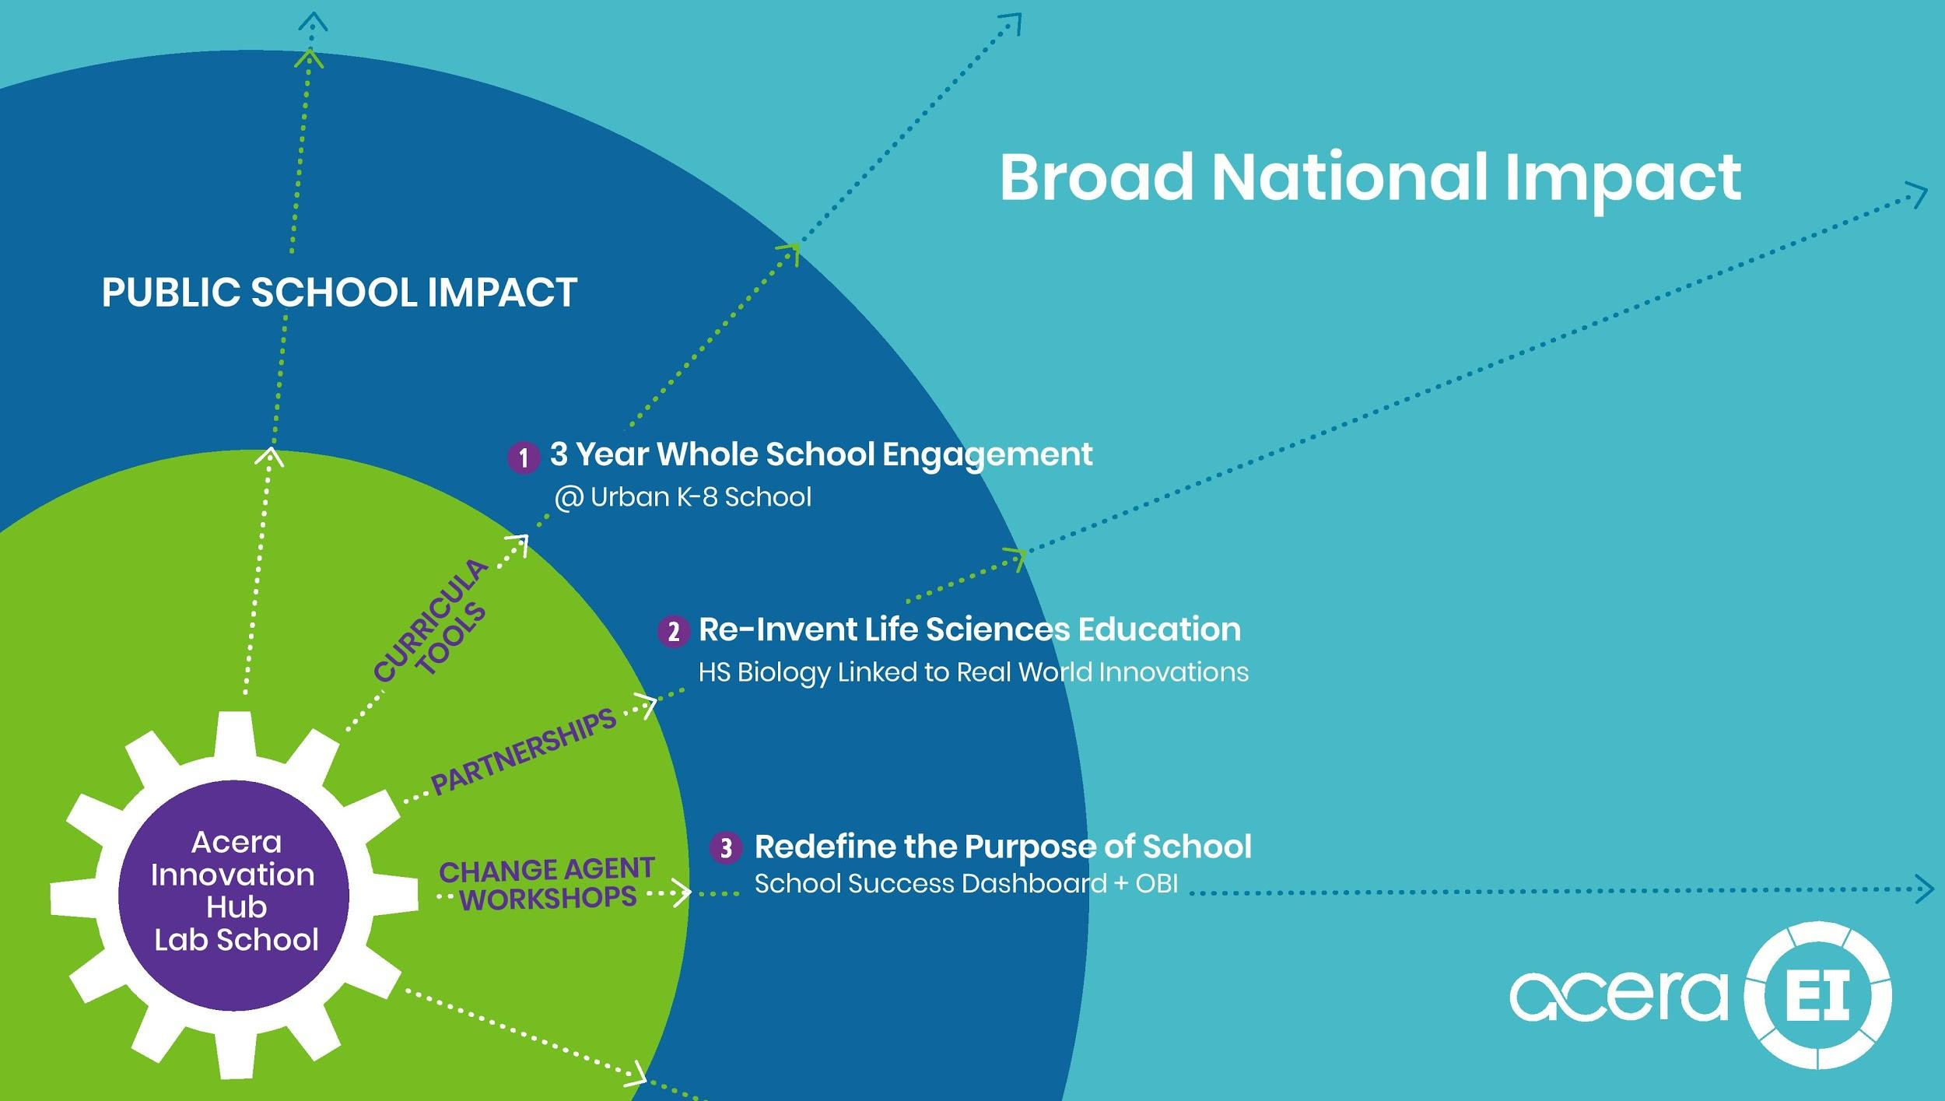

Slide 7
POP UP EXTENSION SCHOOL PROGRAM MISSION
ENABLE STUDENTS TO CONNECT, ENGAGE, AND LEARN VIA REMOTE SCHOOLING
  Safeguard the spirit and innate curiosity of each child
  Focus on inquiry, creativity, and complex thinking
  Emphasize STEM learning areas, developing native capacity
  Enable student’s to pursue their passions and talents. Provide a runway for
  learning so that students can fulfill their potential.
  Leverage Acera’s lab school approach and define a novel way to
  innovate a highly effective pop-up extension school amid the COVID crisis.
  Model Pop-Up Remote Schooling as a possible option for Public Education
  DEVELOP THE NEXT GENERATION OF SCIENTISTS, INNOVATORS AND LEADERS

Slide 8
STUDENT FOCUSED: TAP INTRINSIC MOTIVATION & PURPOSE
Traditional Model =
Age Based Standards
Acera’s Model = Individualized Discovery
Learning = Limited to coverage of state specified content and age-based standards.
Focus on Foundational Knowledge.
Teach to the Middle. Cover content.
Teacher as lecturer and primary source of information.
Convergent Thinking. Memorization of Facts. Predefined Methods & Approaches.
Divide learning by subjects in ways that make education more conveninent to deploy and easier to “prove” coverage of content
Learning = Responsive to student interests, with inquiry and projects, including teachers’ periodic reference to age norms and standards as a floor, not the horizon
Focus on Complex Thinking.
Individualize. Differentiate learning. Cultivate curiosity.
Teacher as facilitator of discovery, with access to world class scientists and mentors and laptops as windows into the world
Divergent, Creative Problem Solving Links to Real World Challenges. Meaningful Work.
Engage students in multi-disciplinary learning in authentic ways that reflect how topics and work happens in the real world
Notes:
The “old” model of education defines learning based upon predetermined topics with predetermined targets for what should be covered each year, based upon typical age expectations.
In this model, when Josie asks about exponents at age 6, the teacher asks her to put her hand down and to focus on subtraction. Josie encounters this over and over gets the message that her questions don’t matter, so she stops asking. And then everyone “equals out” because the brightest students don’t get a chance to learn. The high ability once in evidence in first grade often disappears by fourth.
Once a child has achieved that level of capacity, they are left to wait as the teacher focuses on students who have not yet mastered the basic skills or basic topic areas for coverage.
The big focus for each teacher is a standardized test which checks the box against what children are supposed to know via a list made by people who don’t know the children.
Education is defined through an outmoded lens of “what you know” with modest skill expectations around reading, writing, and math. For gifted elementary students who show up at school on Day 1 already knowing 50% of what is to be “covered” that year, without the need for the first six weeks of review which is typical, and with a pace of learning which is dramatically slower than how their mind operates, we see a model which is a dramatic misfit for our most capable children.
Slowly, these most able children stop asking . . . They get messages from their teachers and peers that their job is to fit in, not to ask hard questions or struggle to learn.
We are raising a nation of box checkers who follow the rules.
The “new” model of education should be defined by a teacher who asks questions and creates a classroom tone in which students engage around topics, understand their relevance in the world, and there is freedom to actually ask questions which don’t have answers.
If a student is ready to ask about a topic, engage with them to explore it. When Josie asks about exponents at age 6, the teacher has permission to go off the text book and to engage and honor that inquiry with real exploration. In order to do that, the teachers’ role should be less about common objective criteria and more about meeting the needs and enabling learning for every child, not just the bottom half of the class. Currently, teachers describe that their hands are tied and even that they will risk their job if they actually differentiate to meet the needs of the highest ability children.
In an era when anyone can look up anything at any time, education is no longer about “knowing” a lot and instead should be based upon your ability to think creatively, ask good questions, filter information, collaborate with others, and take responsibility for your impact on the world.
We need to free our highest potential mathematical, scientific and creative thinkers to pursue inquiry, discovery, and learning.

Slide 9
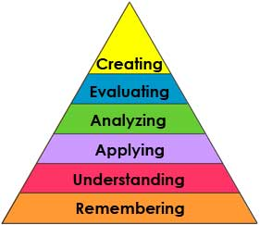
PHILOSOPHY: FOCUS ON COMPLEX THINKING
Challenge:
Typical ly, most classes focus “teaching” and testing, on “knowledge/ remembering.” It is simpler to “prove” content was “learned.” However, without processing & application to a context that is meaningful to the student, the knowledge is not retained,
Acera’s Approach:
Focus 80% of class time on complex thinking and application of knowledge to the real world and purpose-filled needs and projects
Role of teacher = facilitate discovery. Coach. Remove Obstacles. Ask Questions. Share resources. Find experts.
Engage students. Discussions, activities, authentic dialogue, laughter, hands-on projects, not a script.
Teachers are creative learning “entrepreneurs”- empowered to honor the learning interests and needs, defining learning pathways which fit the group and each individual student in a responsive, adaptive way
Updated Bloom’s Taxonomy

Slide 10

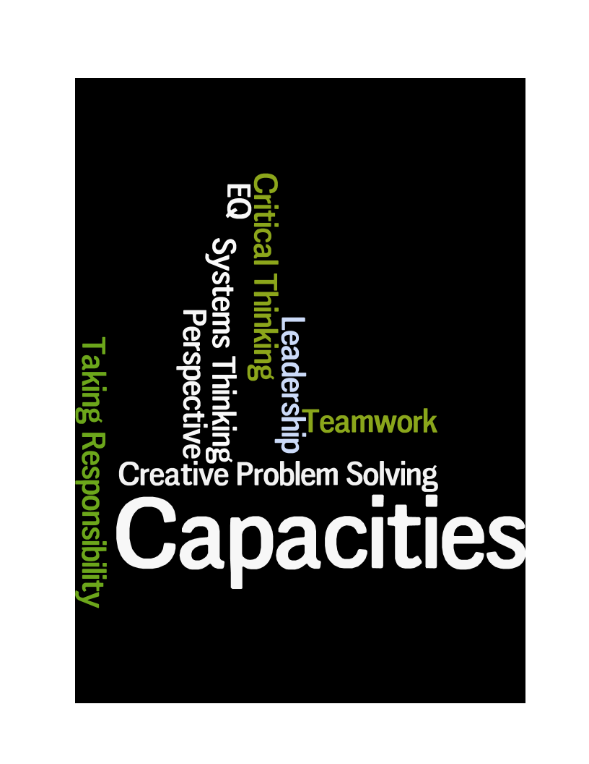
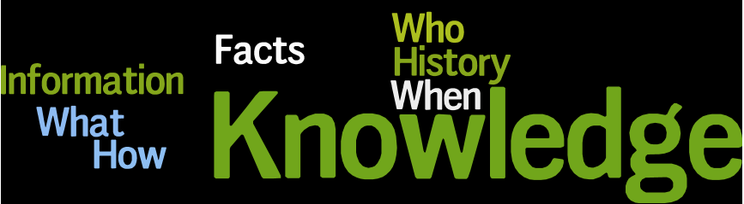
21ST CENTURY TOOLKIT
ACERA FOCUSES ON CAPACITIES, NOT JUST SKILLS & KNOWLEDGE
Notes:
A traditional education model pre determines what is to be learned in a given school year or course. The emphasis is on Knowledge Acquisition.
However, memorization and a copious knowledge bank is now a commodity.
There is also an emphasis on assuring that basic skills are acquired – reading, writing, calculations, spelling, handwriting, how to write a research paper, how to use the library, etc.
However, skills which are outmoded are not pushed aside. . . We still teach cursive and library skills instead of technological proficiency and the ability to filter information. We also have completely new fields of science emerging, and we cannot author textbooks and train teachers fast enough to prepare students for an ever changing world. Let’s put the exploration into their hands and use technological tools to turn around the expectations. Let’s not pretend we can define a factual based test which “covers” what kids should “know” when the people who write the tests don’t know the most important new fields of science which will frame the world in the coming years.
We need to focus instead on building student capacity to be effective in an ever evolving world.
And the most important things to learn – Capacities for being an effective thinker and contributor in the world – are cast aside in traditional classrooms as teachers are pressured to prepare students for tests on knowledge and skills.
Yet, the things which actually matter most are:
Problem Solving 4. Leadership & Emotional Intelligence
Creative Thinking 5. Taking Responsibility for your Impact
Ability to Collaborate 6. Systems Thinking
Teachers are prevented from focusing on these through rigid curricula and through mandated tests on standard topics.
It is very hard to measure these capacities in an authentic way, yet they are the most important for us to develop a nation with scientific acumen and new answers to old problems.

Slide 11

CORE CLASSROOM DISCUSSIONS & PROJECTS
Relating ideas to real-world situations and needs, interdisciplinary, thematic & creative
discussions, assignments and projects unfold.
Students inquire, analyze, discover, create, make.
Learning is personalized and applied to a
broader world context.
Adapting discussions and projects to students’ interests makes it fun, (even joyous) and meaningful.
Authentic, real, projects can be hatched,
Truly student centered and inspired.
Teachers’ construct a classroom learning trajectory around
Essential Questions . . Themes. . . Ideas. . . Cultures & Societies
which become seed kernels, inspirations
science, culture studies, philosophy, language arts, STEM and rich creative learning
Essential academic skills and content are woven into experiences which motivate authentic engagement to learn, to be accountable, to grow skills and knowledge because the learning matters.
11
Notes:
11

Slide 12
DAILY SCHOOL SCHEDULE
Sample Daily Agenda: Built from What is Working in Acera Remote Schooling
“Core Classroom” has a lead teacher, so there would be two concurrent student cohorts (grade 6 and grade 9)
9-10:30 Classroom Community Discussion on Zoom, inquiry-style learning, student sharing of ideas, pieces, projects.
Includes reflection on primary source article homework from night before. Includes “teaching” across disciplines.
10:30 - 12 Individual work time on writing, assignments and projects coming out of morning meeting.
Teacher coaching and peer coaching meet-ups. At least once weekly, one-on-one writing coaching meeting.
12-12:45 Socialize Video Hang-out to prepare lunch & eat and/or play games virtually (cards, D&D, etc.) w/ teacher pop-ins.
12:45-1:30 Exercise requirement: on-line martial arts/ strength / yoga/dance class or outdoor bike / run/ hike.
1:30 - 2: On-line math tutorial Acera curates options (e.g. Aleks) families choose and pay for their own approach.
2-3: Finalize & Submit products and projects. Post by 3pm - the day’s written, math, projects, and exercise products/photos
3-3:30 Break
3:30-5:30 Enrichment / Elective Courses High engagement discussion rich and hands-on courses chosen by Student
Offerings will be determined based on community interests. (Computer science, lab science, arts, social sciences)

Slide 13
SAMPLE MS/HS ELECTIVE COURSES 3:30 – 5:30pm
Please Refer to Actual/Current Electives/Enrichment Courses for current options:
https://www.aceraschool.org/enrichment-programs/after-school-programs/
Topic Area | Monday | Tuesday | Wednesday | Thursday | Friday
Lab Sciences Could include LabXchange by Amgen Foundation | 9^{th –} 12th Grade Gene editing, secret life of plants, microbiome, science of chocolate Enroll 3X week | 6^{th-10th} grade Biowearables & Inventions for Me Enroll 2x week. | 9^{th-12tjh} grade Lab science class Enroll 3X week | 6th – 10th grade Biowearables & Inventions for Me Enroll 2x week. | 9th – 12th grade Lab Science Class Enroll 3X week Mon, Wed, Fri
Maker Space, Art & Architecture | Biophyllic design; nature as inspiration for art, architecture, solutions, and new inventions Enroll 2X week | eFashion, circuitry, Arduino microcomputing: Create My Design Idea | Constructing a sculpture/ bench / structure In your backyard w/ found natural objects that make a metaphorical statement | eFashion, circuitry, Arduino microcomputing | Biophyllic design; nature as inspiration for art, architecture, solutions, and new inventions Enroll 2X week
Social Systems & Simulations | Power, change, & humanity: Putting Revolutions On Trial Enroll 2X week | Philosophy Salon: Strategies for argumentation to impress your friends ☺ Enroll 1-2x / week | Power, change, & humanity: Putting Revolutions On Trial Enroll 2X week | Philosophy Salon: Applications to Contemporary Issues Enroll 1-2X week | Genesis of World Religions Enroll 1x week
Engineering, Computing & environmental Science | Composting systems, gardening, Enroll 1x week. | Biomaterials: Climate Change Engineering Solutions Enroll 2x week. | Learning to code to create something new which teaches about a topic you care about Enroll 1-2 x week | Biomaterials: Climate Change Engineering solutions Enroll 2x week. | Learning to code to create a game or tell a story Enroll 1-2 x week
Parent Galvanizers Can Help Us Coalesce/Launch New Offerings. Contact enrichment@aceraschool.org or popup@aceraschool.org
Other sample topics include: Economics, Psychology, Art, Cooking, Home-based woodshop, Film making, Government, Culture Studies

Slide 14







ABILITY BASED MATH
Concept Mastery Progress Tracking
Principles We Practice:
Pre-Assess so student can learn based upon what they are ready to learn. Engage in a math program which is responsive to their learning rate and needs, focusing on understanding, not formula execution.
For Pop Up School:
Family chooses whether student enrolls to *mirrors the school-year class *engage in an elective offering, or *uses this opportunity to shore up or accelerate mathematical capacities.
Aleks On-Line (Adaptive to student. Focuses on problem solving not rote learning. Uses AI to flex with the student. Graphs Progress re: concept mastery)
* The approach family chooses will be identified, managed, and paid for by the family and not actively integrated into Pop-up school experience.
14
Notes:
14

Slide 15
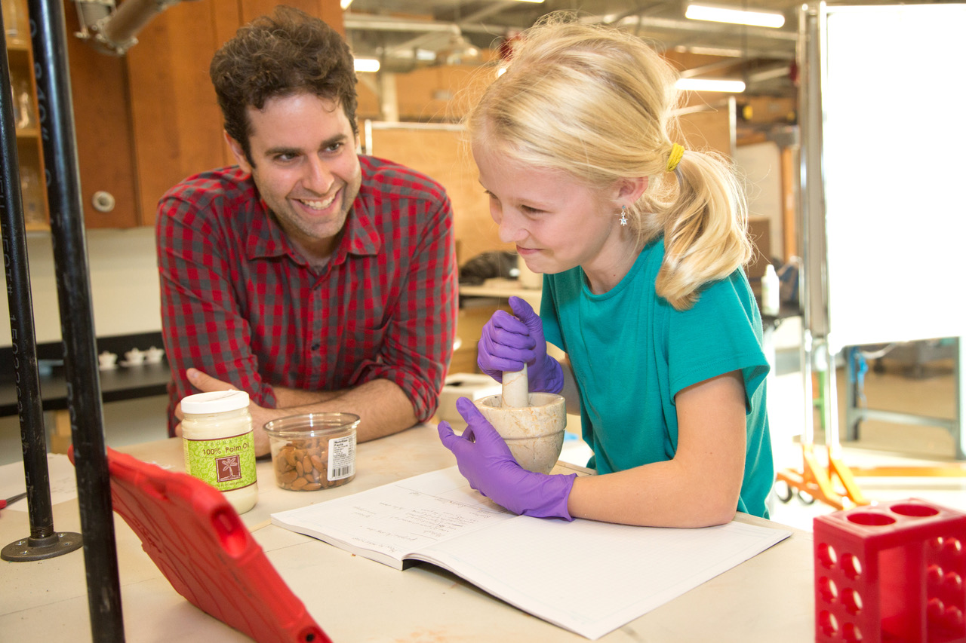
OUR EDUCATIONAL APPROACH MAPS TO EVIDENCE & WORLD
Focus on creative, divergent problem solving, Not convergent thinking & execution
Deep STEM exposure / engagement
Purpose filled, high engagement learning & projects, levity, fun, and joy as part of schooling experiences Not worksheets & textbooks
Cross disciplinary learning & deep thinking Not division by subjects to “prove” it was covered Not organizing school around fear of standardized tests
Individualized learning paths based on potential, needs, interests, Not standards or age based
Link Learning to Innovations of Today and Challenges of our tim

Slide 16
CORE LEARNING STRATEGIES
Pre Assessment Evaluate each student’s abilities at start of school year. Include nationally normed, computer based test by NWEA called “MAP” which adapts to student ability level during testing. We raise the ceiling on tests until we determine the right learning level for each student.
Individualized Learning & Differentiated Instruction Collaborative, flexible approaches that serve each student’s needs, built and planned with input from pre assessments, teachers, parents, and student. Teachers support students in ways which are relevant for their individual skill level, profile, and interests.
Dialogue & Inquiry Emphasis Students exchange ideas in an open, inquiry oriented environment. Expansive, systems oriented thinking and perspective taking emphasized. Complex ideas and ethical discussions abound.
Thematic & Contextual Activities relate to the real world. Thematic learning helps address wide ability ranges. Problems can be seen as opportunities for impact.

Slide 17
IN CORE CLASSROOM POP-UP SCHOOL. . .
Writing Is A Critical Focus
This is an age where writing skill development is of paramount importance.
The most enjoyable way for students to make progress in this is when they write about something that matters to them – a real world issue, an elective they picked, for a real purpose – campaign, etc.
Coach Into Student Work / Writing
A mix of different types of writing – creative, expository, research – will be expected of students as a follow on to daily morning discussions, overnight articles assigned, and to in authentic ways which respond to topics students feel passionate about / invested in.
Spelling and grammar taught in context, individualized to student level, in writing feedback and in one-on-one student:teacher coaching meet-ups.
Whole class and small group mini lessons are created and customized to student needs
Honoring student interests and giving choice motivates participation, accountability, and growth.
Peer coaching meet-ups also augment this process.
Students’ development of their own assessment rubrics and then self reflection and peer feedback against these rubrics is an effective strategy for multiple levels of student buy-in and learning.
Literature or Writing Groups
We could add literature or fiction writing classes as part of the Elective Course afternoon offerings.
Parent galvanizers who coalesce students to enroll can help us ”pop up” new options.

Slide 18
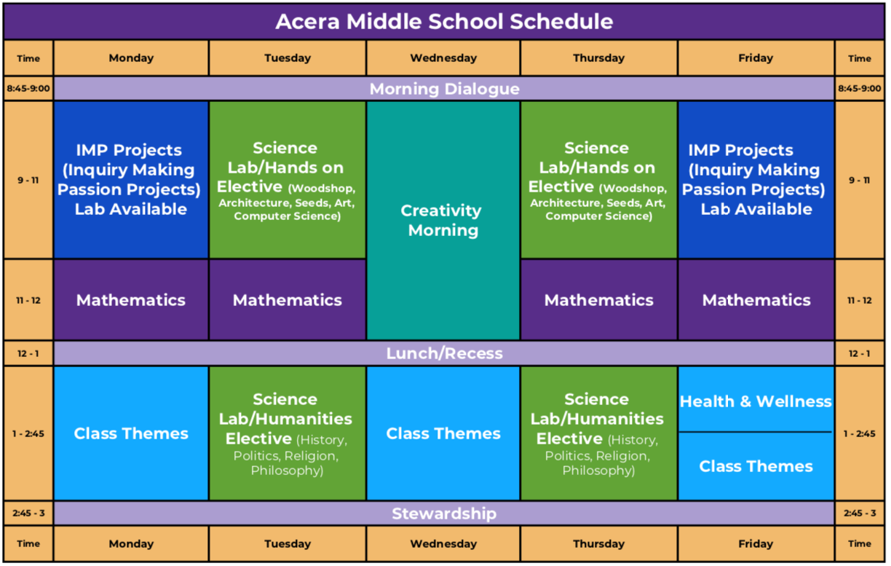
Pop-Up Extension School Inspired by our Grade 6-9 Program

Slide 19
We Use Evidence-Based Pedagogical Practice
Schools often have habits of operating which do not align with what neuroscience and psychology tell us about how people best grow and learn.
Short time blocks, switching classes, following a text book instead, Longer time blocks with learning that links to real challenges and applications, enables understanding, motivation retention
Pattern & reward “getting it right” with rigid expectations of what “right” looks like instead, divergent thinking, flexibile modalities and ways to show content mastery; rewarding fluency of thinking to solve problems
Motivate via extrinsic rewards / grades instead, tap intrinsic motivation and engage students in meaningful work
Collapse speed & intelligence instead let students work at their own rate to be their best self.
Lecture, listen, test does not foster deep learning or retention; instead, engage complex thinking
Homework norms should fit with frontal lobe development
Pressure for output can lead to stress, anxiety, depression whereas meaningful work and voice in one’s learning path leads to curiosity and better retention of material, and increased overall wellbeing
Assess with one single “grade” in a subject instead, focus on development of skills and mastery. Coach for growth. Understand that organization, conceptual understanding, classroom participation, follow through on assignments are all different aspects of performance and coach/ comment into each of them
19
Notes:
19

Slide 20
OUR VALUES
Curiosity & Innovation
Discover, innovate & learn with a voracious mind. Maintain a sense of wonder in our world. Enable freedom and joy in learning. Engage challenges as opportunities.
Community
Respect others. Support others to become the best version of themselves. Use talents to make a positive difference. Respect perspectives of others.
Openness
Have a humble heart and an open mind. Communicate with truth & compassion. Embrace diverse ways of seeing the world.
Leadership
Model our beliefs for each other. Be flexible about roles. Be flexible about roles. Enable ownership in others. Be flexible and resilient. Find your inner tenacity. Inspire a shared vision.
Integrity
Be accountable: do what you say you will do, and do the right thing. Make decisions based upon your values. Honor yourself and your own personal potential by challenging yourself to do your best.

Slide 21
OUR CULTURE
What We Are | What We are Not
Inspire Curiosity & Voice. Enable Freedom to Thrive. We safeguard the spirit of each child and their intrinsic spark to learn. We believe in student ownership of their projects and learning. We train skills and judgment. We hold students accountable for being a kind, responsible member of community. Meaningful work. Doing what you think is right because you are using your judgment and creativity to solve problems. Developing thinkers and leaders. | Focused on coverage of curriculum or standardized norms. Pressure to perform. Authoritarian. We do not punish students. Busywork. Doing what you are told because that is what you are supposed to do. Developing box checkers.
21

Slide 22
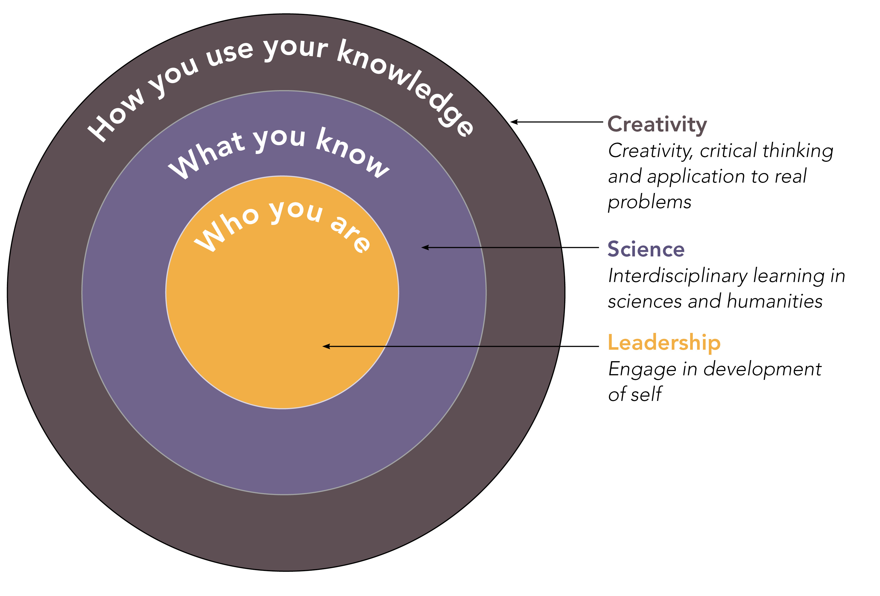
DEVELOPING THE WHOLE PERSON
22

Slide 23



Why Acera? What makes Acera unique?
We tap into -- and foster -- a child’s innate curiosity, motivation to learn, and sense of purpose by:
Providing students with choice and voice, and building individualized, inquiry-based learning plans based on their unique interests and abilities.
Offering early and robust exposure to STEM topics, and connecting them to real world innovations.
Empowering teachers to be facilitators of discovery in classroom, using new tools and technologies and evolving curricula in real time.
The broader mission has always been to transform public education.
Acera was created as a lab school to show—and test—what’s possible in education.

Slide 24
COSTS: 2 MONTH POP UP ACERA EXTENSION SCHOOL
Cost: $2800 Core School Schedule 9am-3pm
Option: Priced per class for 3:30-5:30 Electives offered Mondays-Fridays
New MS& HS options start May 4
Substantial addition offerings being added for June, July, August 2020
Assumes: Home WiFi, Tech platform (chromebook, ipad, laptop) for student use
Next Step: Email popup@aceraschool.org
Spread the word – to assure that your preferred “course” is a “go”
You can galvanize a new Pop Up School Cohort
Parent Roles: Advocate (outreach to public schools). Galvanizer (to “sponsor” elective or new cohort)
501c3 Nonprofit Organization

Slide 25
Questions & Next Steps
Next Step:
Enroll in 3:30 – 5:30 Elective / Enrichment Course: https://www.aceraschool.org/enrichment-programs/after-school-programs/
Send an email to popup@aceraschool.org with your interest
Read updates https://www.aceraschool.org/remote-learning/popup-extension-school/
Galvanize others to enroll too!

Slide 26

A New Generation, Fearless & Ready
Future generations could emerge from their education with early and robust exposure to real world problem solving and critical thinking skills, robust STEM knowledge, empowered to bring their talents alive in the real world, and motivated to participate as
citizens, problem solvers, team members, and leaders.
Notes:
We may not get to this slide. Likely discussion with unfold from prior slide to its logical place depending upon engagement and interest. If presentation is done in a static format or with large group, then this slide will function as the close for that discussion.

Slide 27

Contact popup@aceraschool.org
For core school program interest
and
Contact enrichment@aceraschool.org
For Electives/Enrichment course interest

